Slide 1
NOJ season 1
Fang Wang

Slide 2
season 1
question 1 Output
question 2 Date
question 3 Calculate A+B
question 4 The reversal of a Two-digit number
question 5 Area and Volume
question 6 Grades
question 7 Find the biggest number
question 8 How many digits
question 9 Math function I
question 10 Math function II

Slide 3
How to write a program?
Get rooms
Step 1: declare variables
Step 2: input data
Step 3: calculate
Step 4: output
which data type to declare depends on the size of the value for a variable you need.
Store data
calculate
print the result
Notes:
which data type to declare depends on the size of the value for a variable you need.

Slide 4
Variable --------empty box/room
  Most programs need a way to store data temporarily during program execution.
  These storage locations are called variables.

Slide 5
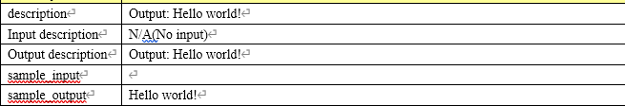
question 1 Output

Slide 6
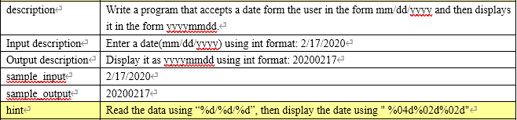
question 2 Date

Slide 7
Step 1: declare variables
#include <stdio.h>
#include <stdlib.h>
int main( )
{
int month, day, year;
scanf("%d/%d/%d", &month, &day, &year);
printf("%04d%02d%02d\n", year, month, day);
return 0;
}
Step 2: input data
Step 3: output

Slide 8
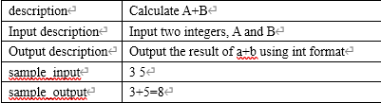
question 3 Calculate A+B

Slide 9
Step 1: declare variables
Step 2: input data
Step 3: calculate
Step 4: output
int a, b, sum; // declare 3 variables
scanf("%d%d", &a, &b); // input 2 numbers
sum=a+b; //add those 2 numbers
printf("%d+%d=%d\n", a,b,sum); //output sum

Slide 10
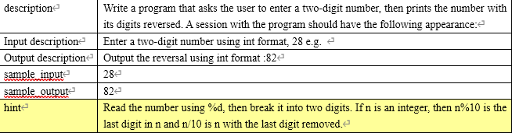
question 4 The reversal of a Two-digit number
scanf("%d", &n);
printf("%d%d\n", n % 10, n / 10);

Slide 11
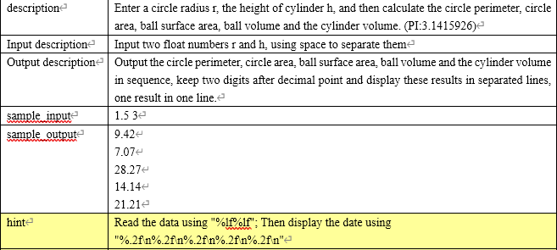
question 5 Area and Volume

Slide 12
Step 1: declare variables
Step 2: input data
Step 3: calculate
Step 4: output
double r,h,l,s,sq,vq,vz,PI=3.1415926;
scanf("%lf%lf",&r,&h);
l=2* PI *r; //circle perimeter
s= PI *r*r; //circle area
sq=4* PI *r*r; //ball surface area
vq=4.0/3* PI *r*r*r; //ball volume
vz= PI *r*r*h; //cylinder volume
printf("%.2f\n%.2f\n%.2f\n%.2f\n%.2f\n",l,s,sq,vq,vz);

Slide 13
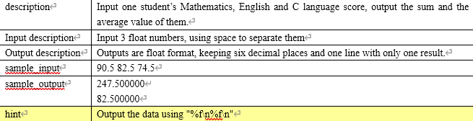
question 6 Grades

Slide 14
double ma,en,c,sum,aver;
scanf("%lf%lf%lf",&ma,&en,&c);
sum=ma+en+c;
aver=sum/3;
printf("%f\n%f",sum,aver);

Slide 15
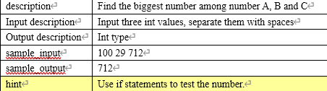
question 7 Find the biggest number

Slide 16
scanf("%d%d%d",&a,&b,&c);
max=a>b?a:b;
max=max>c?max:c;
printf("%d",max);

Slide 17
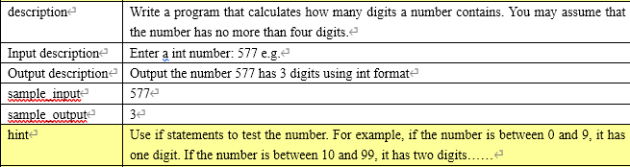
question 8 How many digits

Slide 18
scanf("%d",&a);
if (0 < a && a < =9) printf("1\n");
else if (a<=99) printf("2\n");
else if (a<=999) printf("3\n",a);

Slide 19
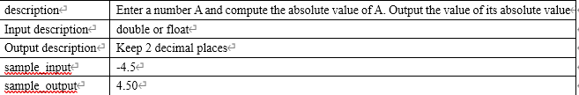
question 9 Math function I

Slide 20
#include <math.h>
scanf("%lf", &a);
printf("%.2f\n", fabs(a));

Slide 21
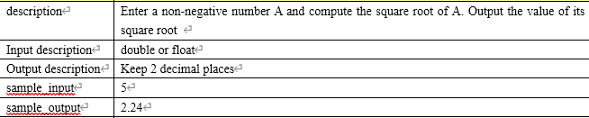
Math function II

Slide 22
#include <math.h>
scanf("%lf",&a);
printf("%.2f\n",sqrt(a));

